Slide 1
DPhil Transfer of Status
University of Oxford
Professor
Stephen J. Roberts
Candidate
Shaan A. Desai
7 October 2020

Slide 2
Overview
01
02
03
04
05
06
07
08
09
Introduction
Background
Inductive Biases
- Graph Networks
- Neural ODE Networks
- Energy-preserving Networks
Challenges
Variational Integrator Graph Networks (VIGNs)
Chaos
Uncertainty
Other Projects
Timeline
02

Slide 3
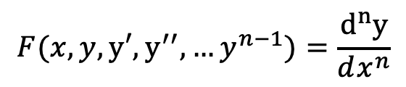
Introduction: dynamic systems I
Dynamic systems are all around us:
Economics
Finance
Physics
Genetics
Modeling them presents an interesting and practical challenge to the scientific community
Applied math approach
Data-driven approach
In this presentation we focus our attention on physics and bridging the applied math approach with the data-driven approach via inductive biases.
Concretely, we want to find some F (for ordinary differential equations) s.t.:
$$F(x,y,y′,y^{′′},…y^{n−1})=\frac{d^{n}y}{dx^{n}}$$
03

Slide 4
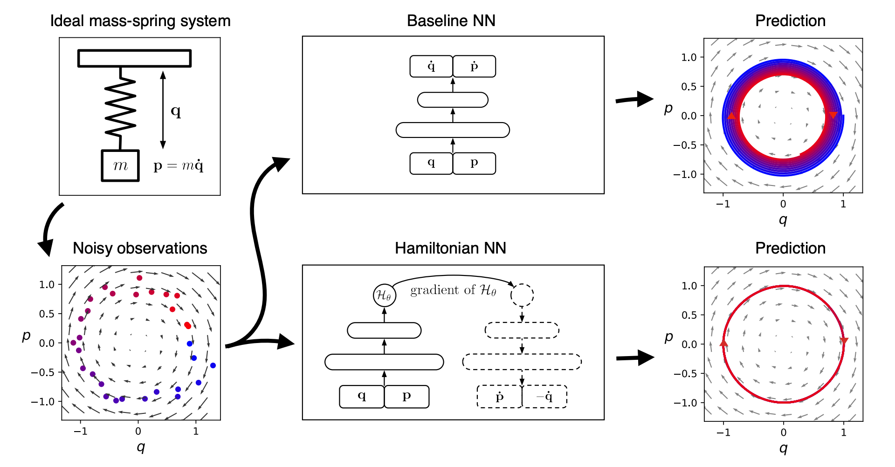
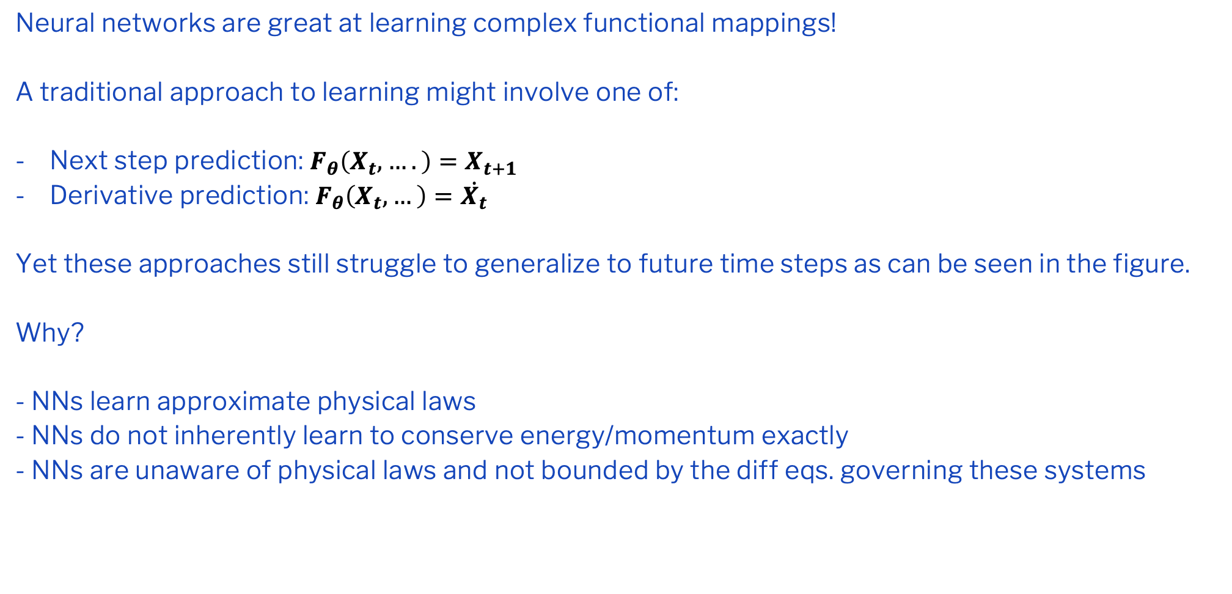
Introduction: dynamic systems II
Neural networks are great at learning complex functional mappings!
A traditional approach to learning might involve one of:
Next step prediction: $F_{θ}\left(X_{t},….\right)=X_{t+1}$
Derivative prediction: $F_{θ}\left(X_{t},…\right)=\dot{X_{t}}$
Yet these approaches still struggle to generalize to future time steps as can be seen in the figure.
Why?
- NNs learn approximate physical laws
- NNs do not inherently learn to conserve energy/momentum exactly
- NNs are unaware of physical laws and not bounded by the diff eqs. governing these systems
Adapted from Greydanus et.al [1]
03

Slide 5
Inductive Biases
An inductive bias is any prior information or knowledge used to guide a system. For example, Convolutional Neural Networks inherent in their design tackle problems with spatial complexity. As such, their inductive bias is spatial filtering/processing.
Concept and definition
As we saw, NNs struggle to learn basic laws. However, by incorporating physics knowledge into NNs we can improve learning. Broadly, these priors serve to bridge our theoretical expectations with observed data.
Physics and Neural Networks
Graph Neural Networks: structural inductive biases
Neural Ordinary Differential Equations: integrative inductive biases
Energy Conserving Networks: phase-space conserving inductive biases
Advances
05

Slide 6
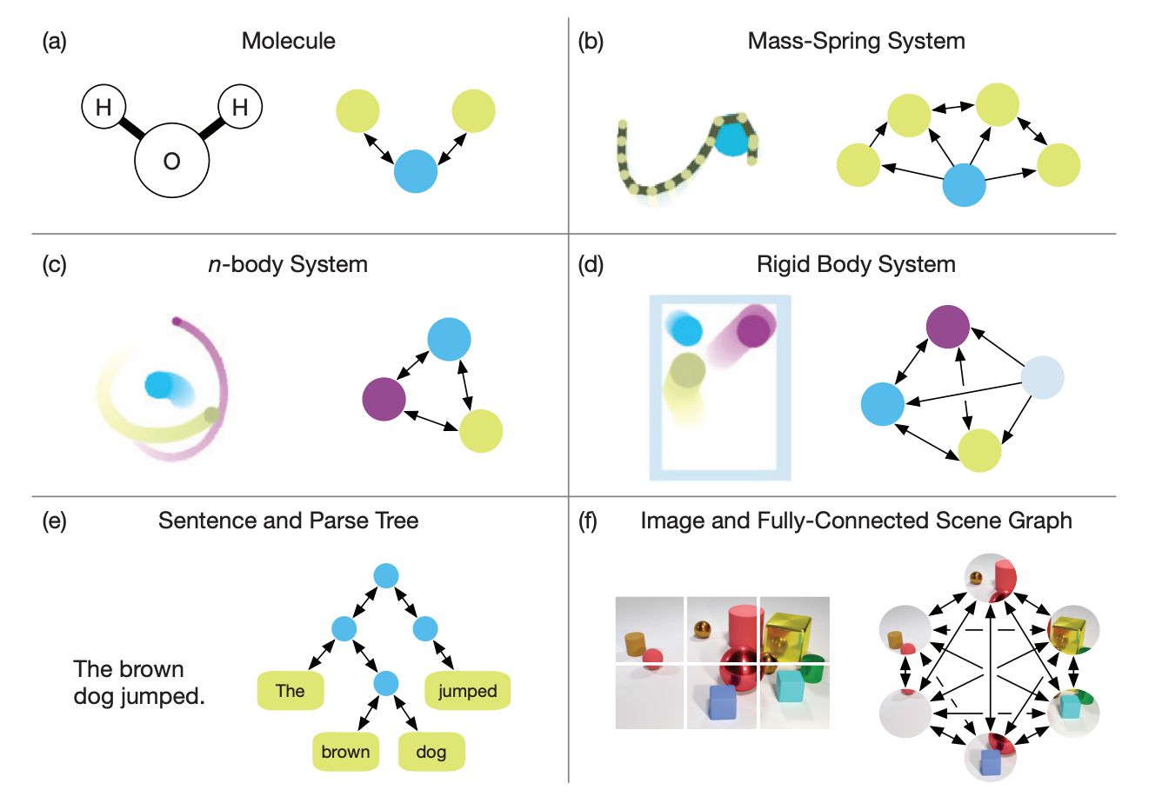
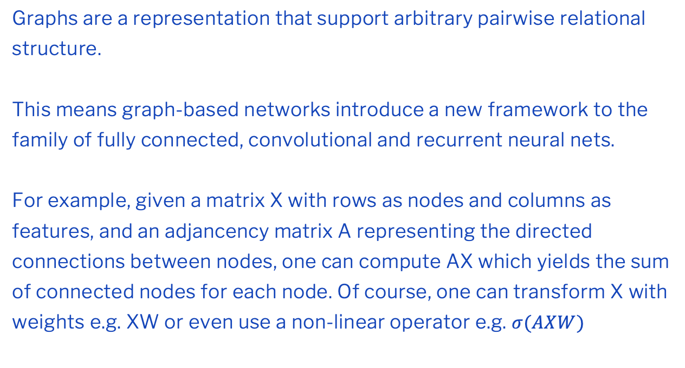
I. Graph Networks
Graphs are a representation that support arbitrary pairwise relational structure.
This means graph-based networks introduce a new framework to the family of fully connected, convolutional and recurrent neural nets.
For example, given a matrix X with rows as nodes and columns as features, and an adjancency matrix A representing the directed connections between nodes, one can compute AX which yields the sum of connected nodes for each node. Of course, one can transform X with weights e.g. XW or even use a non-linear operator e.g. $σ(AXW)$
Adapted from Battaglia et.al [2]
04

Slide 7
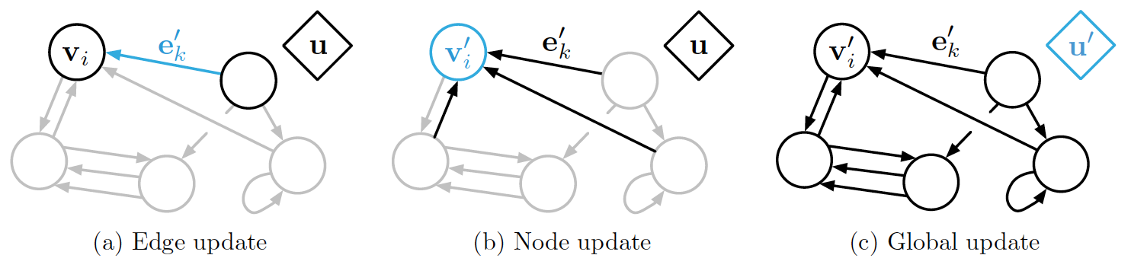
II. Graph Networks
A graph is a tuple (Vertices, Edges, Globals)
Graph networks take a graph as input and output an updated graph
An example (4 body problem where particles are connected with springs and evolving over time)
- Vertices (V) contain node attributes e.g. position, momentum
- Edges (E) contain relational attributes e.g. spring constants
- Globals (U) contain unchanging parameters with time e.g. gravity/drag
04
Notes:
Add equations here

Slide 8
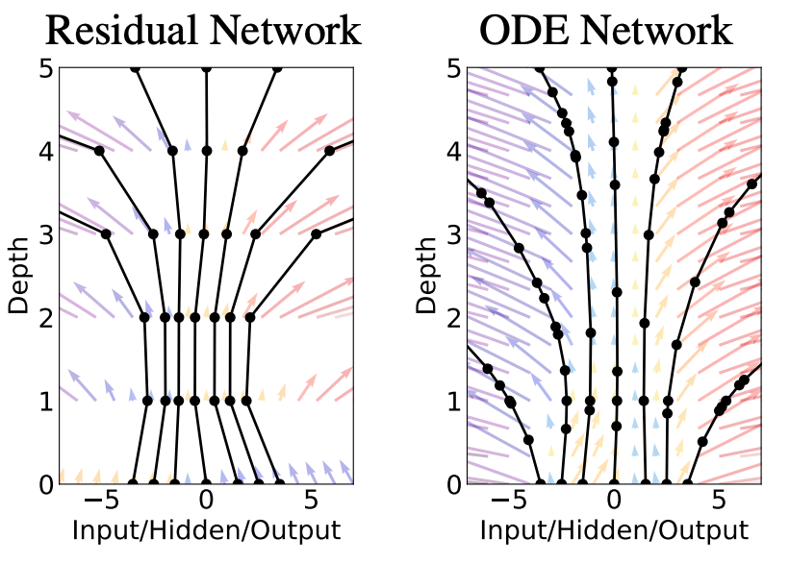
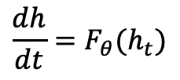
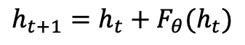
Neural ODE
How do we integrate a differential equation predicted by a NN?
Traditionally, we might use a NN to compute a derivative then pass this derivative into a scipy integrator.
This integration step would naturally cause the NN to continually compute hidden layers i.e. the NN becomes continuous depth
Neural-ODE presents a way to tackle this problem using the adjoint method so the complexity of computing the gradient scales linearly
Traditional Resnet:
Continuous Limit:
$$h_{t+1}=h_{t}+F_{θ}(h_{t})$$
$$\frac{dh}{dt}=F_{θ}(h_{t})$$
Adapted from Chen et.al [3]
04
Notes:
Add equations here

Slide 9
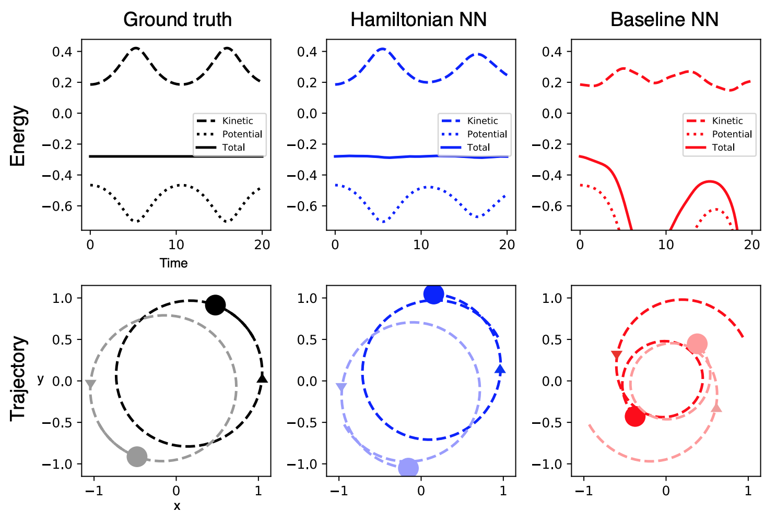
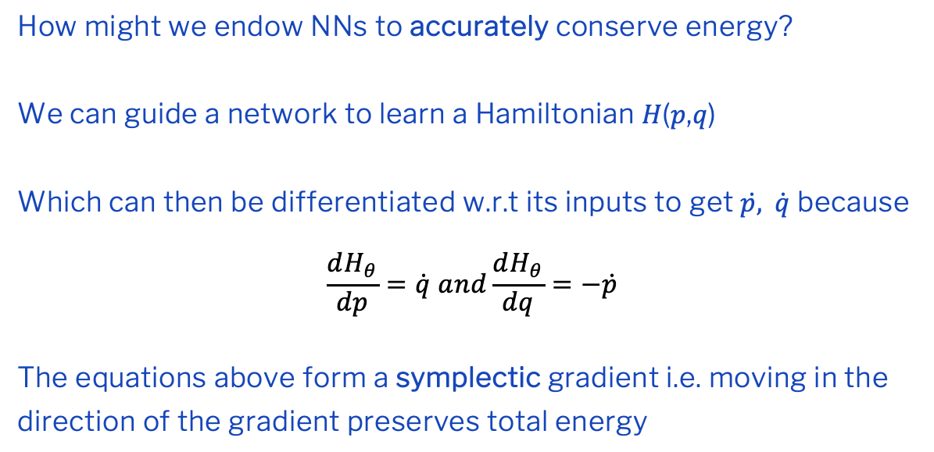
Hamiltonian Neural Networks
How might we endow NNs to accurately conserve energy?
We can guide a network to learn a Hamiltonian 𝐻(𝑝,𝑞)
Which can then be differentiated w.r.t its inputs to get $\dot{p,} \dot{q}$ because
$$\frac{dH_{θ}}{dp}=\dot{q} and\frac{dH_{θ}}{dq}=−\dot{p}$$
The equations above form a symplectic gradient i.e. moving in the direction of the gradient preserves total energy
Adapted from Greydanus et.al [1]
04
Notes:
Add theta component

Slide 10
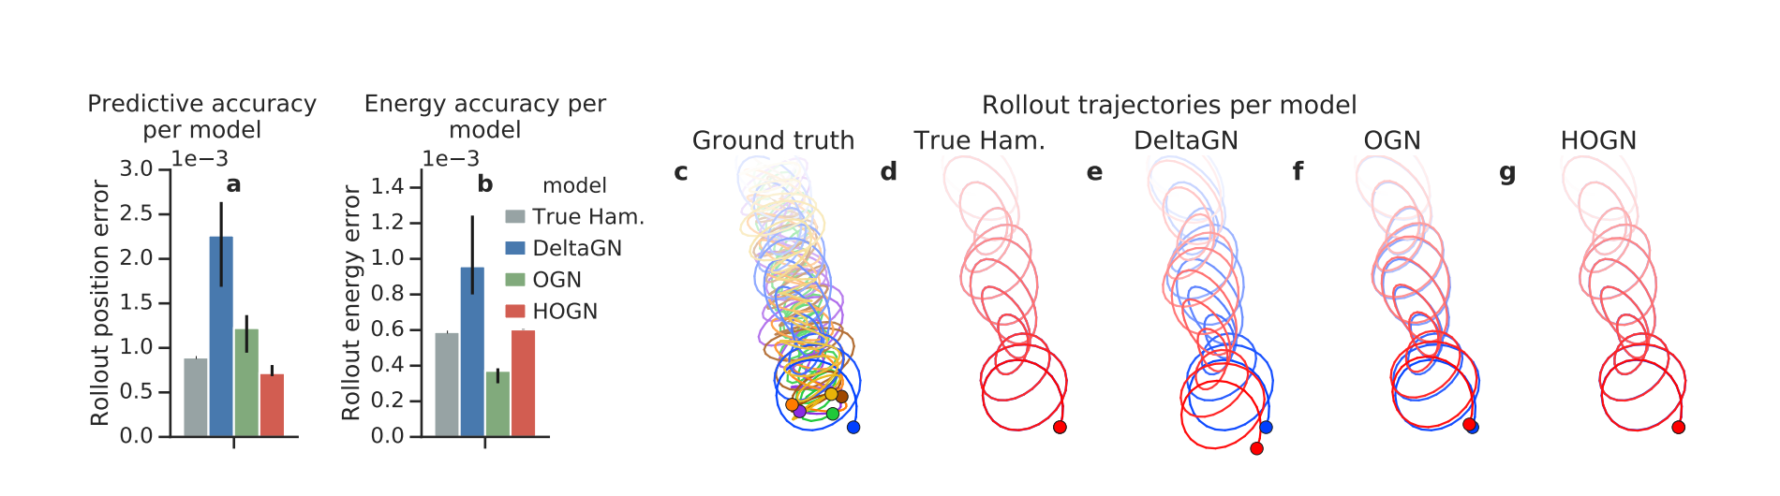
Combined Inductive Biases
How might we combine these inductive biases to solve large N-body systems that are energy conserving?
Sanchez et.al.[4] show that it is possible to achieve this result by using a graph to learn a Hamiltonian.
Step 1: given an input state-vector reshape it for a graph network
Step 2: use a graph network to predict a Hamiltonian
Step 3: use Hamiltonian derivatives (via autograd) in a Neural-ODE to predict the next-state
Adapted from Sanchez et.al [4]
04

Slide 11
Question
How can we scale to large real-world problems and preserve accuracy in a data-efficient manner? For example, if we only have a few measurements of a large N-body system – is it possible to learn the dynamics of such a system? How to best combine inductive biases to tackle such problems?
Limitations
Question
Can we use energy preserving networks to learn chaotic trajectories precisely? In other words, are energy-preserving networks enough to maintain chaotic trajectories or do we need to design new networks?
Question
What are the statistical guarantees physics informed neural networks provide? Do some systems benefit more from Lagrangians or Hamiltonians?
07

Slide 12
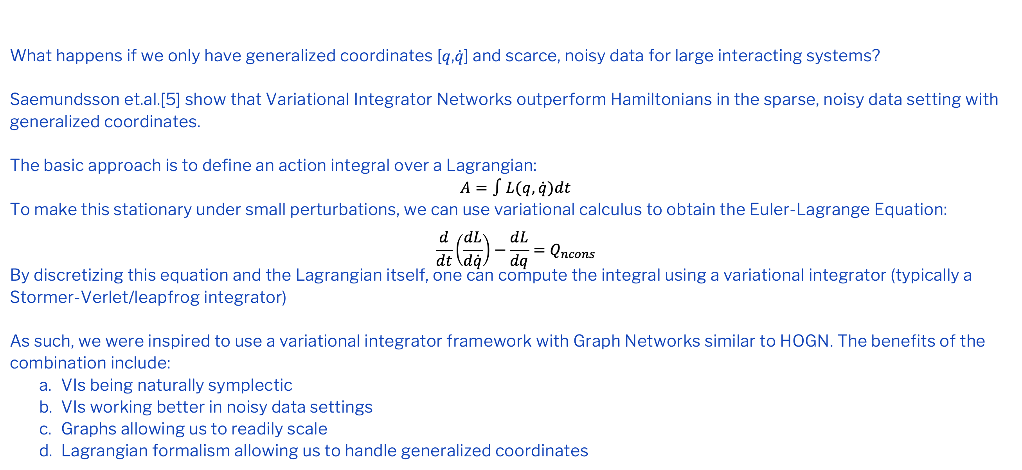
Variational Integrator Graph Networks (VIGNs)
What happens if we only have generalized coordinates [𝑞,$\dot{q}$] and scarce, noisy data for large interacting systems?
Saemundsson et.al.[5] show that Variational Integrator Networks outperform Hamiltonians in the sparse, noisy data setting with generalized coordinates.
The basic approach is to define an action integral over a Lagrangian:
$$A=∫L(q,\dot{q})dt$$
To make this stationary under small perturbations, we can use variational calculus to obtain the Euler-Lagrange Equation:
$$\frac{d}{dt}\left(\frac{dL}{d\dot{q}}\right)−\frac{dL}{dq}=Q_{ncons}$$
By discretizing this equation and the Lagrangian itself, one can compute the integral using a variational integrator (typically a Stormer-Verlet/leapfrog integrator)
As such, we were inspired to use a variational integrator framework with Graph Networks similar to HOGN. The benefits of the combination include:
VIs being naturally symplectic
VIs working better in noisy data settings
Graphs allowing us to readily scale
Lagrangian formalism allowing us to handle generalized coordinates
04

Slide 13
Variational Integrator Graph Networks (VIGNs)
04

Slide 14
Results (Noiseless Setting)
5 body spring
gravitational
pendulum
04

Slide 15
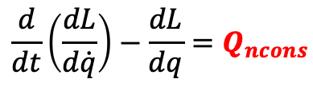
Next Steps
NeurIPS 2020 review scores: 5, 5, 6 and 7
Most feedback centered on ablations
Need to carry out an extensive ablation study:
Symplectic vs. non-symplectic integrators
Graph vs non-graph methods
- Integrator embedded vs. non-integrator embedded
Ideally we would love to extend this method to control systems i.e where Euler-Lagrange is defined as:
In addition, learning from visual data has been presented by Zhong et. al
Application to real world material science/ astronomy problem.
$$\frac{d}{dt}\left(\frac{dL}{d\dot{q}}\right)−\frac{dL}{dq}=Q_{ncons}$$
04

Slide 16
Chaos Systems
Systems that exhibit wildly different trajectories when a small perturbation to the initial conditions is made are called chaotic.
Phys Rev. E paper [6] shows it is possible to use HNNs to learn chaotic motion of Heinon-Heiles
However: - results show that they cannot learn precise trajectories.
- scaling this to the double pendulum results in much poorer performance as can be seen below.
We are interested in developing a system that can, with minimal training data, learn to preserve energy tightly to make learning of chaotic systems easier.
04
Increasing initial angles of both pendulums going right
Notes:
What is a chaotic system

Slide 17
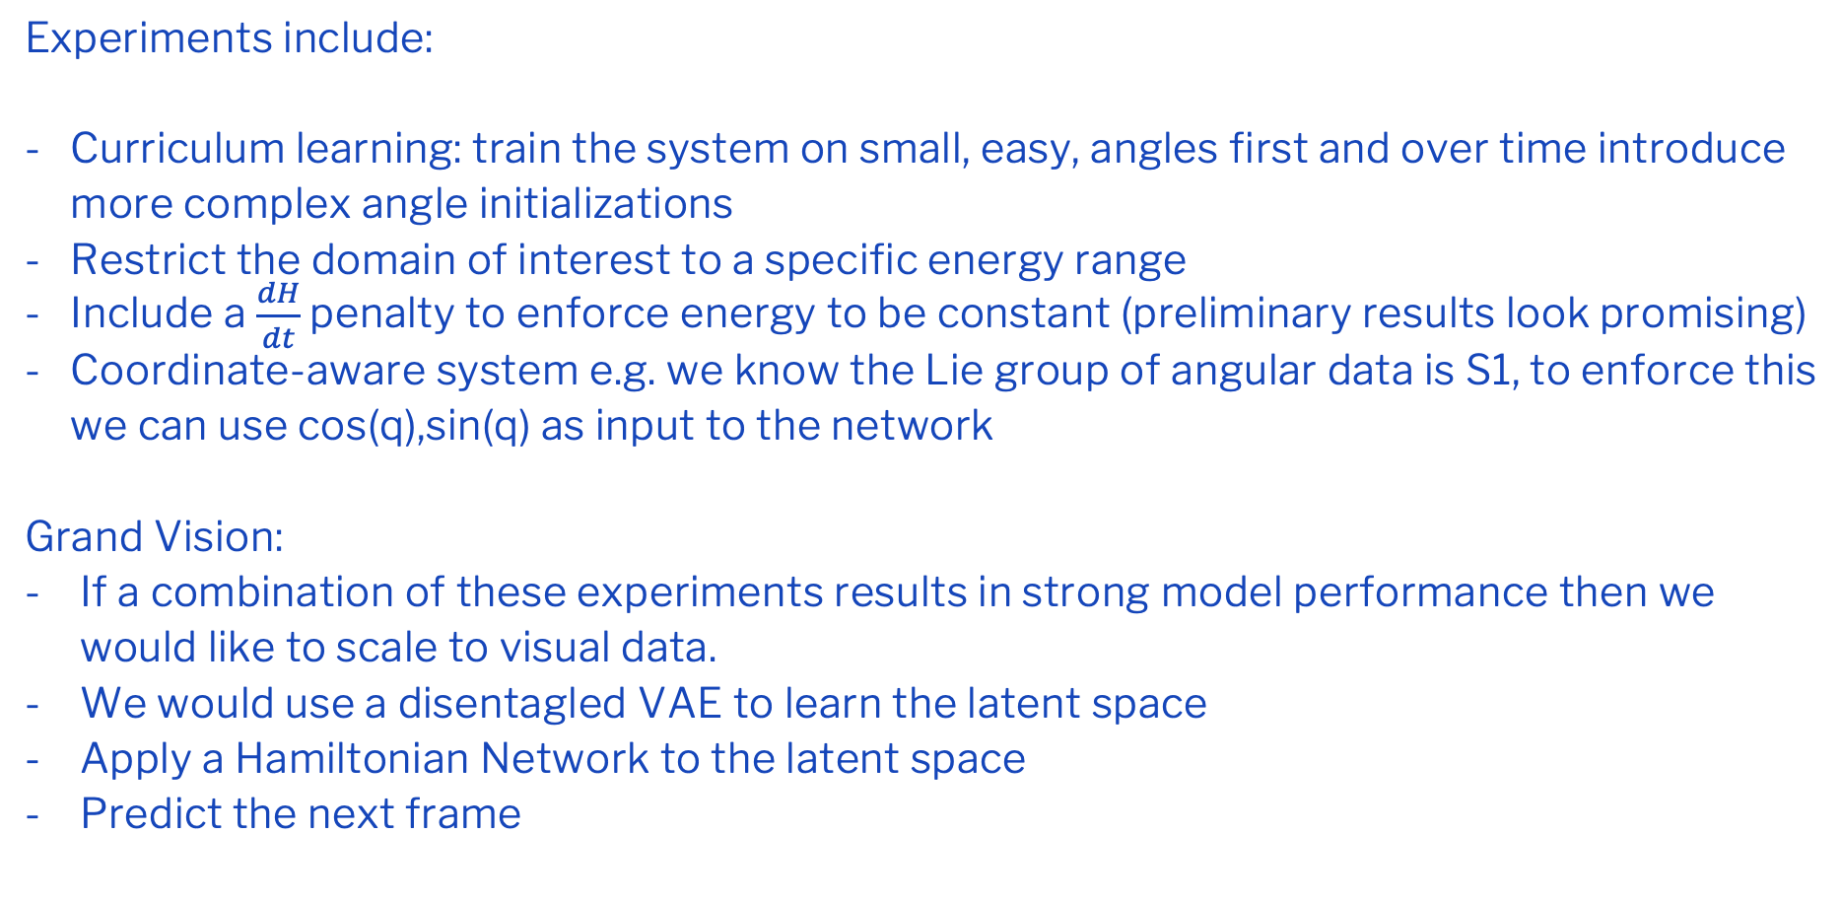
Chaos Systems
Experiments include:
Curriculum learning: train the system on small, easy, angles first and over time introduce more complex angle initializations
Restrict the domain of interest to a specific energy range
Include a $\frac{dH}{dt}$ penalty to enforce energy to be constant (preliminary results look promising)
Coordinate-aware system e.g. we know the Lie group of angular data is S1, to enforce this we can use cos(q),sin(q) as input to the network
Grand Vision:
If a combination of these experiments results in strong model performance then we would like to scale to visual data.
We would use a disentagled VAE to learn the latent space
Apply a Hamiltonian Network to the latent space
Predict the next frame
04
Increasing initial angles of both pendulums going right
Notes:
What is a chaotic system

Slide 18
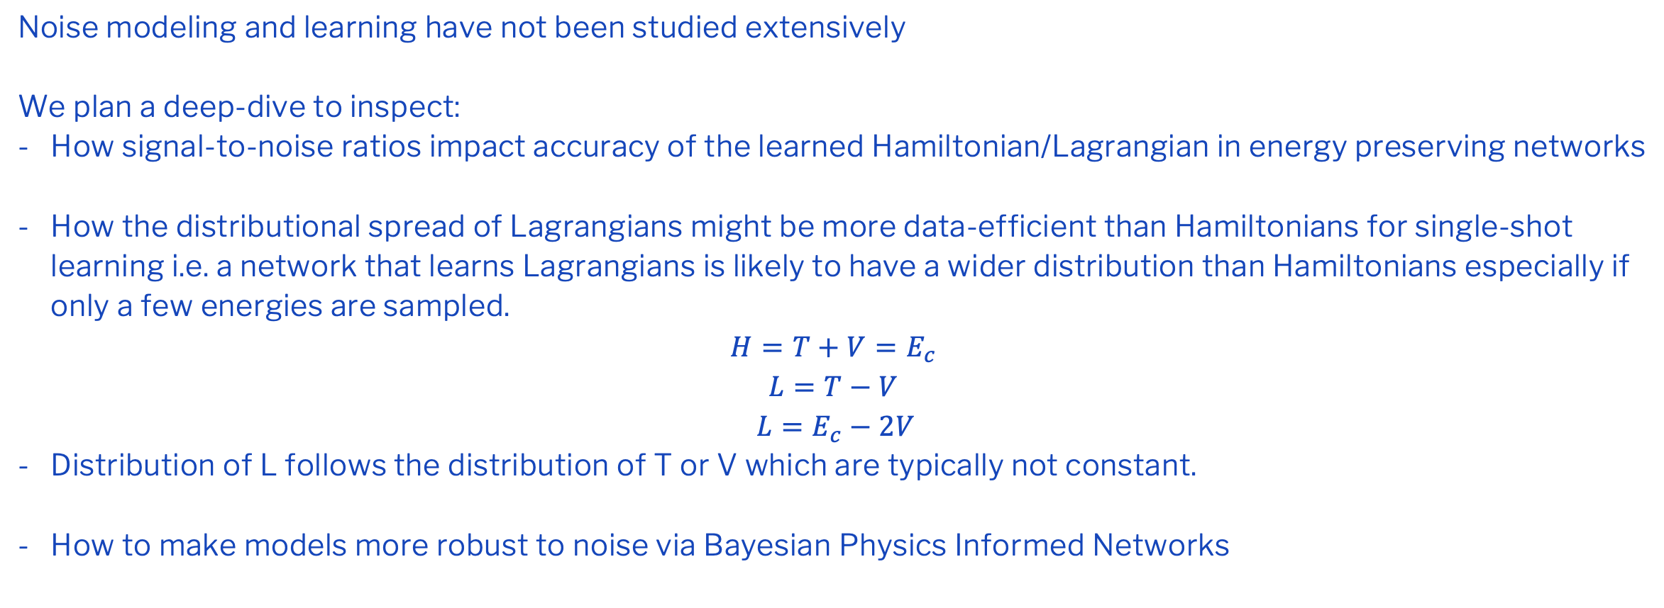
Distributions
Noise modeling and learning have not been studied extensively
We plan a deep-dive to inspect:
How signal-to-noise ratios impact accuracy of the learned Hamiltonian/Lagrangian in energy preserving networks
How the distributional spread of Lagrangians might be more data-efficient than Hamiltonians for single-shot learning i.e. a network that learns Lagrangians is likely to have a wider distribution than Hamiltonians especially if only a few energies are sampled.
$$H=T+V=E_{c}$$
$$L=T−V$$
$L=E_{c}−2V$
Distribution of L follows the distribution of T or V which are typically not constant.
How to make models more robust to noise via Bayesian Physics Informed Networks
04

Slide 19
Other Areas
Evaluate the effectiveness of graph neural networks at capturing Forces between particles e.g. are the network edge weights of a GNN interpretable?
We have established a collaboration with the materials science department (David Howey) to use physics based networks to learn the governing equations of fluid flow in batteries.
We are keen to also investigate how inductive biases could improve model based RL.
We would also like to push the boundaries:
Is it possible to learn chaotic trajectories from visual data?
How might physics informed networks help learn wavefunctions in QM?
04

Slide 20
Timeline
04

Slide 21
References
[1] S. Greydanus, M. Dzamba, and J. Yosinski. Hamiltonian Neural Networks. In H. Wallach, H. Larochelle, A. Beygelzimer, F. d. Alche-Buc, E. Fox, and R. Garnett, editors, Advances in Neural Information Processing Systems 32, pages 15379{15389. Curran Associates, Inc., 2019.
[2] P. W. Battaglia, J. B. Hamrick, V. Bapst, A. Sanchez-Gonzalez, V. Zambaldi, M. Malinowski, A. Tacchetti, D. Raposo, A. Santoro, R. Faulkner, C. Gulcehre, F. Song, A. Ballard, J. Gilmer, G. Dahl, A. Vaswani, K. Allen, C. Nash, V. Langston, C. Dyer, N. Heess, D. Wierstra, P. Kohli, M. Botvinick, O. Vinyals, Y. Li, and R. Pascanu. Relational inductive biases, deep learning, and graph networks. arXiv:1806.01261 [cs, stat], Oct. 2018. arXiv: 1806.01261.
[3] R. T. Q. Chen, Y. Rubanova, J. Bettencourt, and D. K. Duvenaud. Neural Ordinary Dierential Equations. In S. Bengio, H. Wallach, H. Larochelle, K. Grauman, N. Cesa-Bianchi, and R. Garnett, editors, Advances in Neural Information Processing Systems 31, pages 6571{6583. Curran Associates, Inc., 2018.
[4] A. Sanchez-Gonzalez, V. Bapst, K. Cranmer, and P. Battaglia. Hamiltonian Graph Networks with ODE Integrators. arXiv:1909.12790 [physics], Sept. 2019. arXiv: 1909.12790.
[5] S. Saemundsson, A. Terenin, K. Hofmann, and M. P. Deisenroth. Variational Integrator Networks for Physically Meaningful Embeddings. arXiv:1910.09349 [cs, stat], Oct. 2019. arXiv: 1910.09349.
[6] A. Choudhary, J. F. Lindner, E. G. Holliday, S. T. Miller, S. Sinha, and W. L. Ditto. Physics enhanced neural networks predict order and chaos. arXiv:1912.01958 [physics], Nov. 2019. arXiv: 1912.01958.
04

